Slide 1
zMine
By: Austin Cheng, Bryan Wu, Connor Jeng

Slide 2
Table of Contents
Introduction
Game Process
Code Explanations
User Manual
Demo

Slide 3
Introduction
Objectives:
Try not to die
Mine and bomb tiles
Bomb enemies
Collect gold
Beat the clock
Have fun!
It’s a fun 2D mining game

Slide 4
Game Process

Slide 5
Enter a new world!

Slide 6
Mining gold and silver...

Slide 7
Enemies!?...

Slide 8
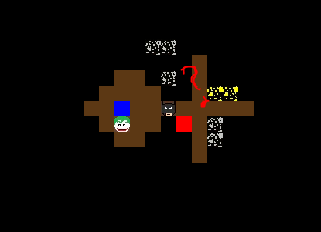
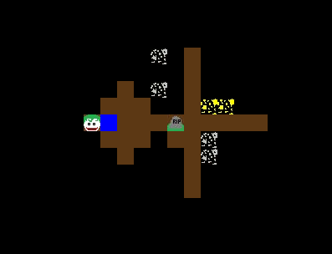
Traps!!!

Slide 9
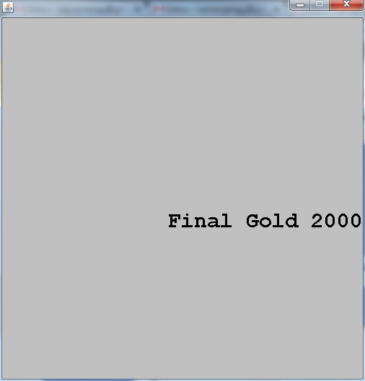
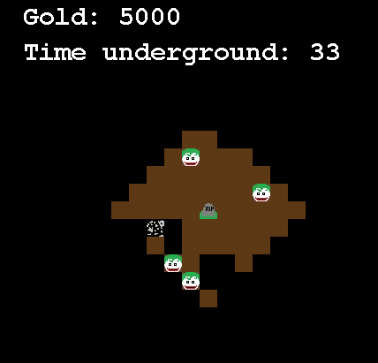
Game Over

Slide 10
Code Process

Slide 11

Character
Methods
public boolean isAlive()
public void setAlive()
abstract void takeDamage( int damage );
public boolean updatePos( int changeX, int changeY )
public void drawMe( Graphics g)
Variables
private int x;
private int y;
private int vX;
private int vY;
private int hp;
private World w;
private Color color;
boolean alive;
private int count = 0; //used for mining

Slide 12
Enemy and player
Enemy Variables
private int vX;
private int vY;
protected int hp;
private Color color;
Timer move;
Timer attackTimer;
Player Variables
private int gold;
private int bombs;
private boolean bombWait;

Slide 13
Enemy and player
Enemy Methods
public void ai()
public void move()
public void attackAnimation( int x, int y)
public void enemyAttack( Player c)
Player Methods
public void bomb()
public void mine()
public int getGold()
public setBombWait( boolean b)
public void addGold()

Slide 14
Tiles
Methods
public void destroyTile()
public void getTile()
public boolean isPassable()
public Color getColor()
public void drawSelf( Graphics g)
public void setImage( Image i)
Variables
boolean pass;
boolean destroyed;
int loot;
private int c;
private int r;
private Image image;
private Color color;
private World world;

Slide 15
World
Variables
int xDim;
int yDim;
public Tile[][] theWorld;
ArrayList<Player> thePlayers = new ArrayList<Player>();
ArrayList<Enemy> theEnemies = new ArrayList<Enemy>();
static Color brown = new Color( 92, 56, 20 );
Timer bombTimer, attackTimer;
long tStart = System.currentTimeMillis();
int countoftime = 0;

Slide 16
World
Methods
public Tile[][] makeWorld(Tile[][] Tiles, int x, int y )
public Tile[][] createCol( Tile[][] tiles, int x )
public Tile[][] createRow( Tile[][] tiles, int y )
public Tile[][] createCavern( Tile[][] tiles, int x, int y, int cavenRadius )
public Tile[][] createTrap( Tile[][] tiles, int x, int y )
public Tile[][] createEntrance( Tile[][] tiles )
public boolean checkCollision( Player p, Enemy e )
public void enemyDeath( Enemy enemy )
public void playerDeath( Player player )
public int distance( int x, int y )
public void runWorld()
public void tick( int fraps )

Slide 17
World
Methods
public void changePicToAttk( int x, int y )
public void changePicToNull( int x, int y )
public void bombArea( int x, int y, int delay )
public void clearArea( int x, int y, int cavenRadius )
public Player detectPlayer( int x, int y )
public void setDisplayer( Displayer d )
public ArrayList<Enemy> getEnemies()
public ArrayList<Player> getPlayers()
public int getXDim()
public int getYDim()

Slide 18
GUI
Player, Enemies, and Tiles all draw themselves
Some methods from displayer.java which extends JPanel
public void addWorld( World w )
public void paintComponent( Graphics g )
private void drawPlayer( Player player2 )
private void drawEnemy( Enemy enemy2 )
public void drawTile( Tile dTile, int x, int y )

Slide 19
User Manual
Player opens testMine.jar
The player is immediately spawned into a randomly generated map
Use arrows keys to move
Press the “F” key 5 times rapidly to mine
Press spacebar to place a bomb
Game ends when time runs out, dead or alive

Slide 20
Time to play!

Slide 21
Thank You for Listening!

